Slide 1
Implementing
victims’ rights
through
litigation

Slide 2
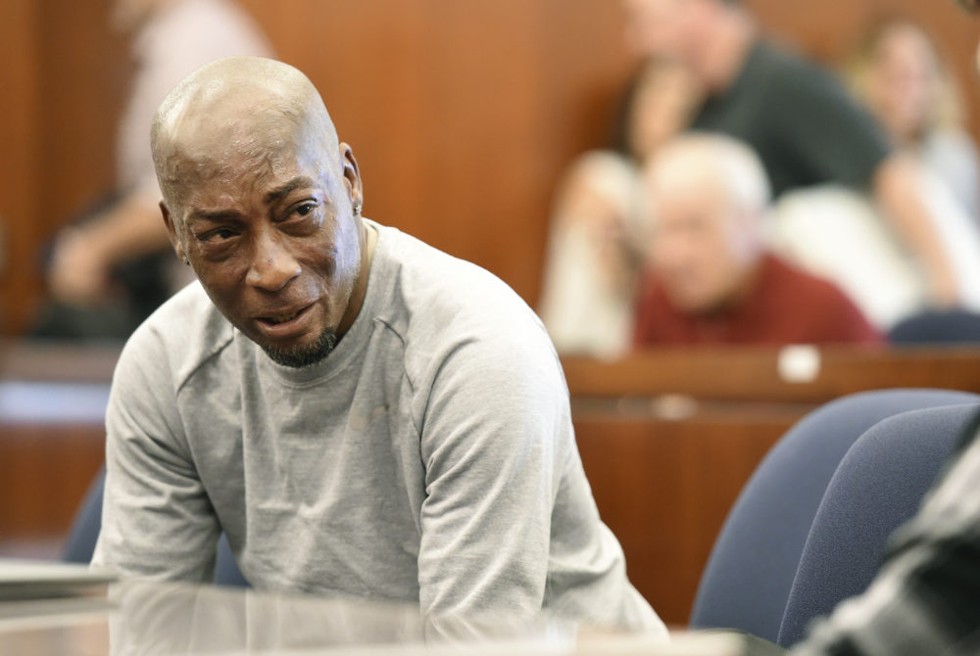
Dwayne Johnson
v. Monsanto
$289 million

Slide 3
Achieving change one case at a time
What is strategic litigation?
Strategic litigation, sometimes also called impact litigation, involves selecting and bringing a case to competent authority with the goal of creating a change in law or policy for a larger group of people.

Slide 4
When to consider litigation?
1. A victims’ right or need that is being largely neglected/ignored
2. A legal norm which can be interpreted to ensure/protect/guarantee the right/need
3. A legal avenue to pursue compliance with the norm

Slide 5
Identification of rights/needs
Individual needs
Group needs (domestic violence, terrorism, victims with disabilities, children etc.)
Needs of all victims: Protection ⋅ Support ⋅ Access to justice ⋅ Compensation/Restoration

Slide 6
What needs to be done to achieve change?
1. Implemenation of legal provisions / policies

Slide 7
Identifying legal norm
National law
Bilateral agreement
EU law
European (human rights) law
International law

Slide 8
What needs to be done to achieve change?
2. Harmonisation of legislation

Slide 9
What needs to be done to achieve change?
3. Change in legislation / policy

Slide 10
How to achieve change?
Who?
How?
What is needed?

Slide 11
Who can start litigation?
Individuals
Groups
Organisations

Slide 12
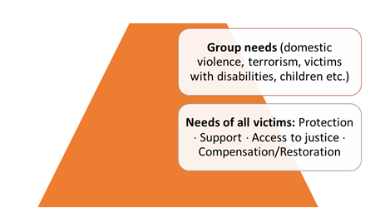
Individual client
`

Slide 13
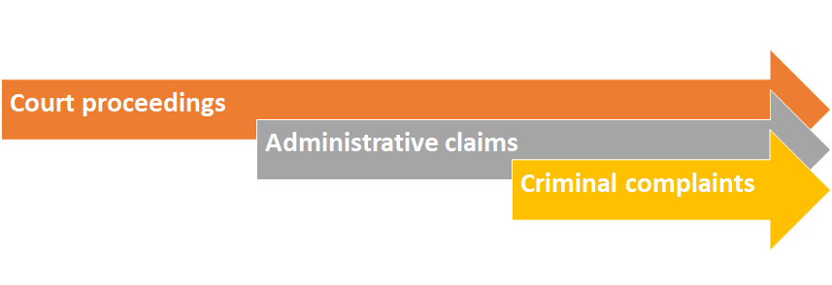
Types of engagement
Hard litigation
Soft litigation
Ombudsperson
Human rights/victims’ rights commission
Collective complaint
Third party

Slide 14
Where to litigate?
National institutions
EU mechanisms
European fora (European Court of Human Rights, European Social Rights Committee)
International mechanisms (human rights bodies)

Slide 15
Some examples of successful litigation
Hate crime against Roma
(Krsmanovača)
Hate crime against persons with disabilities
(Đorđević v. Croatia)
Secondary victimisation of victims of rape
(P. & S. v. Poland, M.C. v Bulgaria)
Use of restraints by medical personnel
(Bureš v. Czech Republic)
Access to health care for foreign nationals
(Hungary)

Slide 16
Synergies
Victim
Specialist organisations
Pro bono lawyers

Slide 17
Thank you!
Aleksandra Ivankovic
Deputy Director
a.ivankovic@victimsupporteurope.eu
+3222310112
www.victimsupport.eu

