Slide 1
DLA Piper Pro Bono Practice in Europe

Slide 2
DLA Piper around the globe
DLA Piper is a global law firm with lawyers located in more than 40 countries throughout the Americas, Europe, the Middle East, Africa and Asia Pacific, positioning us to help clients with their legal needs around the world.
DLA Piper presence
Cooperation firm
*Cooperation Firm

Slide 3
What is pro bono?
PRO BONO = “the free provision
of legal services for the public good”

Slide 4
Our focus areas
CHILDREN’S RIGHTS
MIGRANT RIGHTS
RULE OF LAW

Slide 5
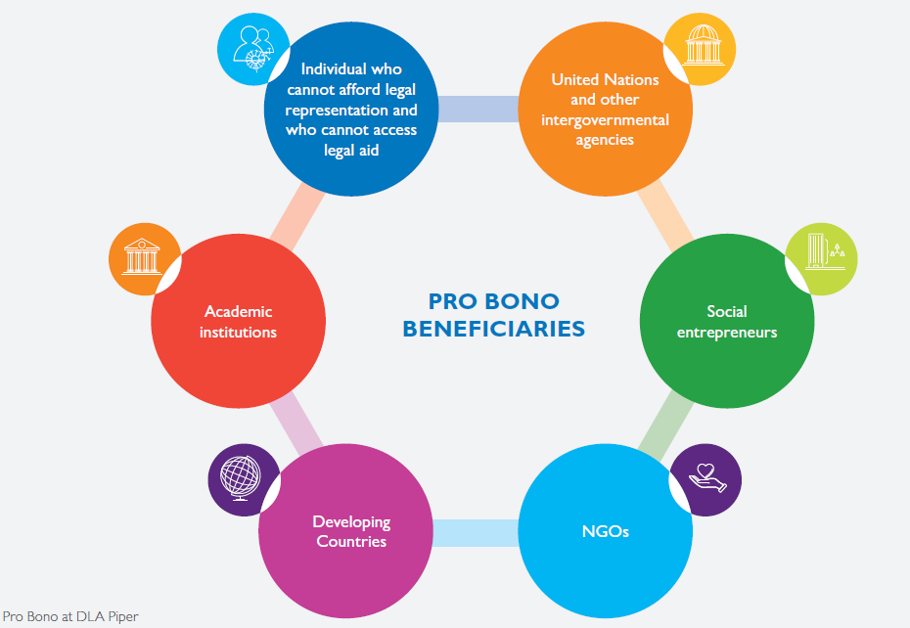
Beneficiaries

Slide 6
Pro bono support
8
GLOBAL
PRACTICE AREAS
10
GLOBAL
SECTORS
TRAINING AND WORKSHOPS
We offer legal training and workshops on topics including drafting, negotiation, advocacy, litigation, legal ethics, interview techniques, alternative dispute resolution and commercial contracts
LEGAL CLINICS TO HELP INDIVIDUALS
We offer detailed and comprehensive legal research on an international scale
STRATEGIC LITIGATION AND ADVOCACY
We undertake strategic litigation to effect systematic change. In certain circumstances, strategic litigation can be used to set a legal precedent or to draw attention to a case as a way of highlighting an area of injustice
COMPARATIVE RESEARCH
AND BEST PRACTICE GUIDES
We offer detailed and comprehensive legal research on an international scale

Slide 7
Pro bono support
8
GLOBAL
PRACTICE AREAS
SECONDMENTS
As a part of our commitment to developing strong and lasting relationships with our key pro bono clients, we provide pro bono secondments to support their legal needs, enabling them to save valuable funds and focus their efforts on their key objectives
LEGAL SUPPORT FOR NGOS
We Provide advice on legal matters that NGOs face in the day to day running of their organisations, such as:
Drafting and revising commercial contract
Employment Law
Copyright, trademarks and intellectual property issues
Website terms & Conditions, privacy and technology law
Legal entity structuring and incorporation
Tax advice
Leases and tenancy issues

Slide 8
Strategic Litigation
What is it?
“Strategic litigation” is a method, used in conjunction with other tools, of taking carefully-selected cases to court to bring about significant change in law, policy or public awareness, as well as seeking justice for the client.
Why do you do it?
Setting precedent
Instigating law reform
Grounds for debate, negotiation and advocacy
Ensuring implementation or enforcement of existing law
Awareness and education
Empowering beneficiaries
Documenting injustice and human rights violations

Slide 9
Strategic Litigation
Potential risks
Lengthy and costly
Setting bad precedent
Risk of harming the client
Damages
Counterclaims

Slide 10
Strategic Litigation
The role of the lawyers
Strategy: Identify (1) the legal issue; (2) the root causes; (3) the necessary change = objective
Map out the stakeholders with common interests
Analyse the evidence of the case
Determine the legal claims (criminal, civil, administrative)
Analyse the law, regulations, case-law, policies, practices
Determine whether litigation is the best way to achieve the expected goals
Risk assessments and how to mitigate them?
Research, drafting legal documents and building arguments
Start litigation and follow-up actions

Slide 11
Strategic Litigation
The role of the NGOs
The local NGO introduces the lawyers to the potential clients, assists in contact and building trust, facilitates access to institutions
Identify stakeholders, experts, witnesses
Collect evidence
Support the client and the relatives
Get in touch with international NGOs for publicity or submission of amicus briefs
Media coverage
Policy and law reform advocacy
Capacity-building, publications and awareness raising

Slide 12
Strategic Litigation
How can DLA Piper support you?
Resources
Set up a team of lawyers
Legal research and argumentation
Legal representation in courts
Including court, legal, admin costs
Strategy
Type of claims
Procedural, judicial processes
Risks assessment

Slide 13
Strategic Litigation
Examples
Belgian case, 2011, Court of Appeal Ghent (13e k.), nr. 2009/AR/2440, 7 September 2011.
The case involved three hearing-impaired students who requested more hours of support from a sign-language interpreter in mainstream secondary education.
French case, 2015, the Supreme Court of Appeal for administrative matters.
The matter involved a survivor of domestic violence who suffered years of physical and verbal abuse at the hands of her ex-husband.

Slide 14
THANK YOU
DLA Piper is a global law firm operating through various separate and distinct legal entities. Further details of these entities can be found at www.dlapiper.com.
This publication is intended as a general overview and discussion of the subjects dealt with, and does not create a lawyer-client relationship. It is not intended to be, and should not be used as, a substitute for taking legal advice in any specific situation. DLA Piper will accept no responsibility for any actions taken or not taken on the basis of this publication. This may qualify as “Lawyer Advertising” requiring notice in some jurisdictions. Prior results do not guarantee a similar outcome.
Copyright © 2018 DLA Piper. All rights reserved.

