Slide 1
Developing a victim-oriented response to terrorism
Levent Altan,
Executive Director
Victim Support Europe

Slide 2
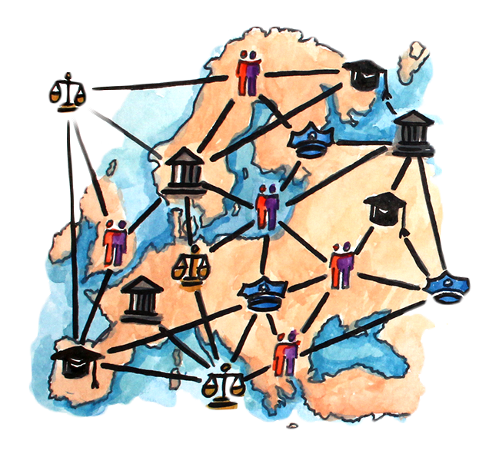
Introduction to Victim Support Europe
Works to establish and improve rights and services for victims in Europe and globally
Helps NGOS, governments and International institutions to develop capacities, learn from each other and cooperate.
Umbrella network for national victim support organisations in Europe
50 Members in 28 countries, mostly in Europe.
Members have around 3000 staff, 20 000 volunteers.
They provide assistance to around 2 million people affected by crime and disasters each year

Slide 3
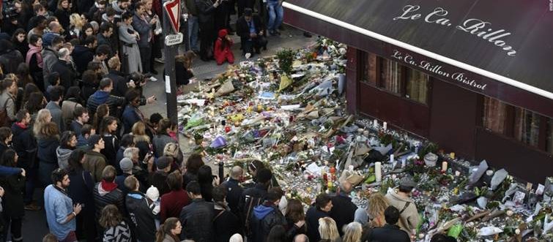
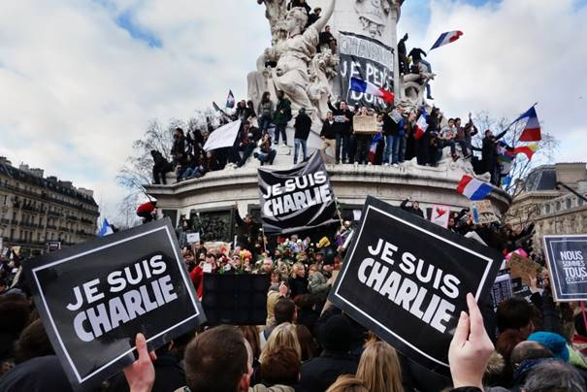
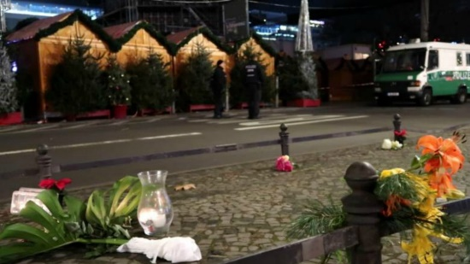
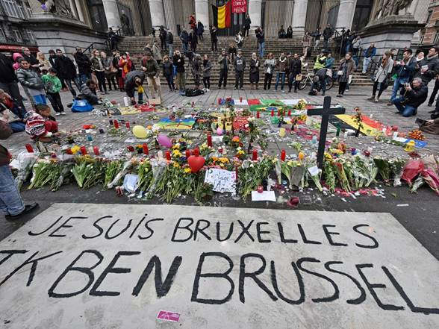
Victim Support Europe and work on Terrorism
Victim Support Europe
SUPPORT TO MEMBERS AND GOVERNMENTS
RESPONSE NETWORK
IFDIS
POLICY

Slide 4
DEVELOPING THE RIGHT RESPONSES FOR VICTIMS OF TERRORISM:
WHAT SHOULD WE DO DIFFERENTLY COMPARED TO OTHER CRIMES AND OTHER VICTIMS?

Slide 5
VICTIM FOCUSED
RESPONSE FRAMEWORK :
Nature of attack
Timeline of action
Actors: mission and services
Who is affected?
Needs of victims
NATURE OF ATTACK Multiple or single attack Multiple or single location Ongoing or concluded Mass or limited casualties Home or abroad Weapon used – bomb, gun, vehicle, CBRN
TIMELINE OF ACTION
NGOs - Generic and national support - Specialist support – terrorism, peer support, specific: – disabilities, religious groups, LGBTI - Spontaneous – housing offers, free taxis, fundraising, | State Actors Victim Support Command and control Emergency responders Hospitals Criminal justice actors Compensation authorities Health and social welfare Schools
Types of Services offered by different actors Prevention – counter-radicalisation, awareness raising, social buy in Preparation - Research, policy dev, training, awareness Response - Victim Single point of contact –victim needs, service co-ordination Victim Support – helplines, victim centre, victim navigator, specialist services (disability changes, therapies), advocacy, long term support, Public awareness and memorials
VICTIMS AND AFFECTED PERSONS
Community/ Wider Population
Witnesses/1st responder
Family and loved ones
Direct victims (present/ harmed)
Planning, Preparation, prevention
Crisis Response
Long term services, self advocacy
NEEDS OF VICTIMS
Specific Groups: terrorism, disabled, relgion, lgbti
Five Common Needs:
Respect/ recognition; protection, support, justice, compensation
Personal Character/ Situation

Slide 6
VICTIMS AND AFFECTED PERSONS
NEEDS OF VICTIMS
Community/ Wider Population
Witnesses/1st responder
Family and loved ones
Direct victims (present/ harmed)
Specific Groups: terrorism, disabled, religion, lgbti
Five Common Needs:
Respect/ recognition; protection, support, justice, compensation
Personal Character/ Situation

Slide 7
Three phases to meeting needs
Planning, preparation, prevention
Incorporate victim expertise in crisis system
Crisis Response
Information to public and victims
Support victims
Medium, Long term services and self advocacy
Complexity of Needs
Training and exercises
Ability to establish infrastructure quickly
Funding surge and management of donations
Develop partnerships, relationships and trust
Defining victims
Data protection and data sharing
Peer support groups
Victim registration
Information
Emotional, practical and financial assistance
Ongoing assessment and watchful waiting
Physical and psychological
Which organisations
Transitions between centres and organisations
Ongoing funding
Ongoing assessment and triggers
Compensation
Memorial Services
Co-ordination
Victim assistance centres
Needs assessment
Death notification
Victim navigators
Immediate therapies

Slide 8
Planning and preparation: key issues
Incorporation of victim expertise in crisis system
Training and exercises: where does victim support fit it?
Ability to establish infrastructure quickly: physical, technical, content
Funding surge and management of donations
Develop partnerships, relationships and trust: multi-agency/ multi sector work, protocols
Defining victims
Data protection and data sharing
Peer support

Slide 9
CRISIS RESPONSE: INFORMATION
INFORMATION IS ABSOLUTELY VITAL
PRINCIPLES: information and communications strategy | Fast, single, reliable, original source Simple and accessible Diverse forms of communication Victim sensitive, regular, personal, repeated Trained personnel | CONTENT What happened Loved ones Practical info: What happens next What do they need to do What services and help are available
MECHANISMS | Single website: public and private Crisis helpline- single national number, Victim/family assistance centre Victim navigator/ support worker Social media
SPECIALS CONSIDERATIONS | Young Foreign Disability

Slide 10
Crisis Response: Support
PRINCIPLES | MECHANISMS
Proactive – outreach and referral Needs focused (assessment) Stepped model Watchful waiting Free, confidential For as long as needed Different forms Everyone’s job | Victim registration Victim assistance centres – safe, multi-agency Victim navigators – needs assessment, emotional support, practical, buffer Status of loved ones and death notification Emergency finances Immediate therapies – psychological 1st aid plus…?

Slide 11
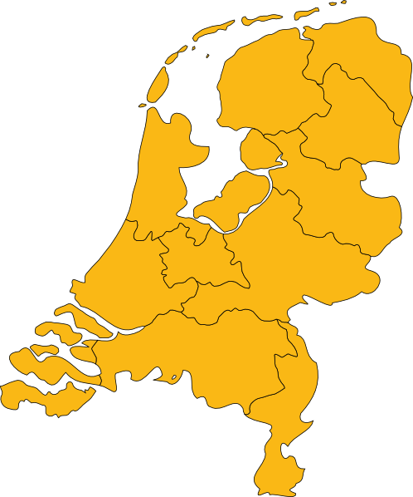
Cross-border victims
Victim abroad
Foreign resident victim
Victim of crime abroad
Foreign victim

Slide 12
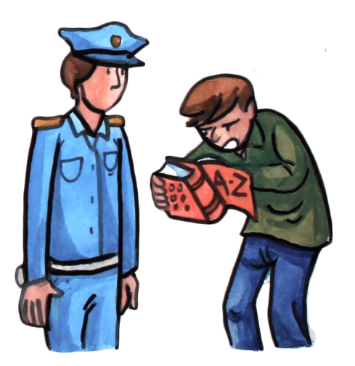
Cross border victims: an added layer of complexity

Slide 13
Cross border victims: Challenges and needs
Language
Information, support provision, rights
Impact of victimisation, support needs
Travel, ID, food, health care, accommodation
Support network, support over borders
Limited time-frame to get information and support
Foreign victims of terrorism have different rights
Culture
Practical
Distance
Timing
Different rights

Slide 14
Support for foreign victims
Support at home and abroad
Specific support to family member abroad
Support in different languages
Support adapted to different culture/background
Support adapted to their practical needs
Flexibility from the system
More time
More co-ordination

Slide 15
Thank you!
Thank you!
Victim Support Europe
Rue de la Loi 235
Brussels
+3222310112
l.altan@victimsupporteurope.eu

