Slide 1
LinCT Toronto 2019
Supporting Cross-Border Victims of Terrorism
Levent Altan,
Executive Director

Slide 2
Set up in 1990 to promote rights and services for all victims of crime in Europe Network of 56 organisations: NGOs, State, Individuals, Universities 31 Countries Over 5000 staff and volunteers Over 2 million victims supported per year
About
Victim Support Europe

Slide 3
21 terrorist attacks in Europe and beyond since 2015 France, Germany, Spain, UK, Sweden, Finland, Russia, Turkey, USA, Bangladesh, New Zealand, Sri Lanka Primary focus – mass victimisation
VSE response to terrorist attacks
International response network | Connecting victims to support | Research and policy development | Capacity building and advocacy

Slide 4
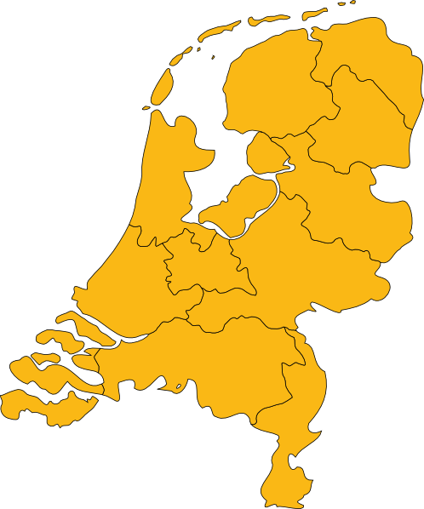
Two scenarios when supporting cross-border victims
Supporting your citizens when affected abroad
Does your terrorism response framework have specific measures for foreign victims in your country?
Does your Framework have specific measures to reach all your citizens affected by an attack abroad?
Supporting foreign victims when attack in your country

Slide 5
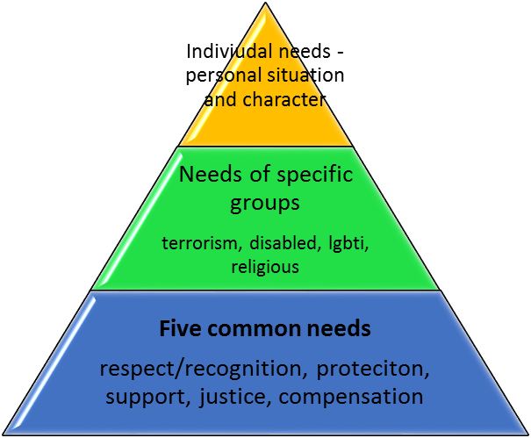
Victims needs is the starting point: Not budget, not resources, not time
Foreign Victims of Terrorism
Respect and Recognition
Support and Information
Access to Justice
Compensation and Restoration
Protection

Slide 6
Main challenges for foreign victims of terrorism compared with national

Slide 7
Cross-border victims are not reaching support

Slide 8
Informing victims and the public
INFORMATION IS ABSOLUTELY VITAL
 | TO PUBLIC , TO DIRECT VICTIMS, VICTIMS PRESENT BUT NOT INJURED | CONTENT What happened Loved ones Practical info What happens next What do they need to do What services and help are available Rights Financial assistance Compensation
PRINCIPLES: information and communications strategy | Fast, single, reliable, original source Simple and accessible Diverse forms of communication Multiple languages Victim sensitive, regular, personal, repeated By Trained personnel
MECHANISMS | Govt: Government ministries, embassies, victim assistance centre, Media: formal, social, informal (tv, radio, web, papers, local, national) NGOS : Victim Support, disaster response groups, community groups (disability, lgbti, religious, ethnic) Transport: train, tram, metro, airport, airlines, travel co’s Services – medical, social welfare etc Single website, crisis helpline- single national number, victim navigator, leaflets, videos, announcements,
CONSIDERATIONS | e.g. Young, foreign, disability

Slide 9
Some core principles in the delivery of effective support
All victims
Respect
Direct interactions
Non-discriminatory
Empower
Universal/ generic and specialist services
Regularly reviewed
Relevant
Institutionalised in structures
Listen
Consult
Participation
Education and self help
For as long as needed
High quality, consistent standards
Transparent
Communication and information – multi-format, simple and accessible
Constant review and improvement
Self realisation
Watchful waiting
Confidential
Stepped model
Targeted, flexible and individualised – based on assessment and different therapies
Public info and direct to victims
Accessible for all: geographical scope,
Proactive - reach out, referral, help them come forward
Co-ordination of services
Free of charge
At home and abroad
Circles of impact
Everyone’s job

Slide 10
Examples of our response for cross-border victims
FRANCE
VSE Member/ in reposnse framework
National VS Access to victim list
NEW ZEALAND
VSE member/ not in response framework
National VS has no list but engaged with crisis response
SRI LANKA
No member/ VS not part of response framework
VSE launches response network
VSE receives foreign victim list
VSE offers practical assistance to France victims
VSE disseminates to in country org to initiate contacts with victims
National orgs co-ordinate with governments to connect with victims
VSE receives information about nationality of victims
Engages with national VS and works with VS Asia to identify national partners
Victims come from range of countries that don’t have relevant support organisations
VSE launches network, engages VSA to find partner in Sri Lanka
VSE launches response network
No subsequent requests for help
Partner identified, but no access to victim info, does not offer support to victims
National VS contacts with embassies – primary focus deceased victims
Few contacts with wider victim group
VSE/INVICTM preparing documentation to disseminate in Sri Lanka

Slide 11
Information and support are a priority
After safety and medical attention, most important immediate needs for foreign victims but often more difficult to access
Success in provision depends on:
Location of attack – home or abroad
Maximising the routes by which victims are informed and connected with support whilst ensuring trustworthiness of info and support
Collaboration, partnership and trust between:
Organisations in crisis response framework
Embassies
Support organisations

Slide 12
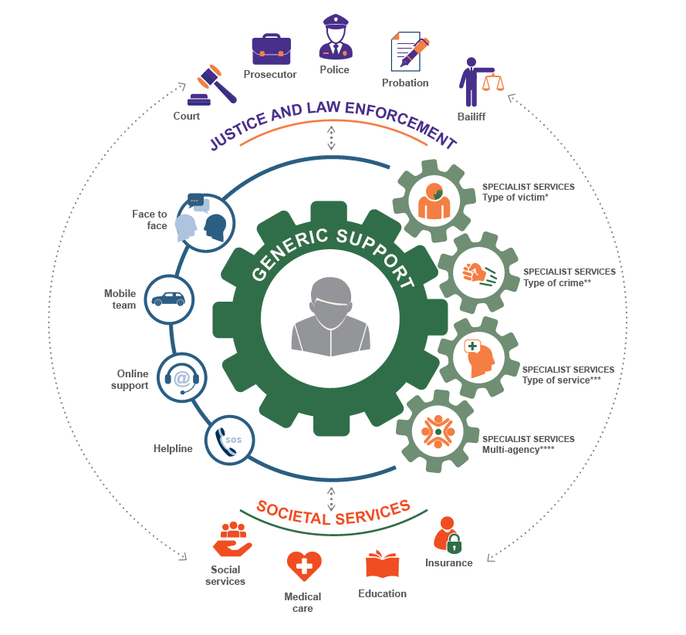
COMPREHENSIVE SUPPORT FOR ALL, BY ALL
Not forgetting:
Individual and community resilience
Victim social support network:
Family, friends, community
Private sector
Oversight, monitoring and review – long term change:
Ombudsmen
Commissioners
Inspectorates
Ministerial responsibility
Self evaluation/ survey
A national network building on existing and creating new services

Slide 13
VSE Standards and Accreditation Process for Full Members
STANDARD 1
Services are available without discrimination
STANDARD 2
Respect the dignity, rights, needs and feelings of the victim
STANDARD 3
Ensuring the confidentiality, safety and privacy of the victim
STANDARD 4
Ensuring tailored responses, according to the individual needs
STANDARD 5
Provide a variety of support options
SOS
STANDARD 6
Delivering for victims through referrals and coordination
STANDARD 7
Ensuring good governance structures
STANDARD 8
Achieving quality through training
STANDARD 9
Improving our services through monitoring and evaluation

Slide 14
Thank you!
THANK YOU!
Levent Altan
Executive Director
l.altan@victimsupporteurope.eu
+3222310112
www.victimsupport.eu

