Slide 1
Human resources slide 1
Supporting Victims,
Meeting Their Needs
Levent Altan
Director

Slide 2
Human resources slide 2
Presentation
European Union – Functioning and Laws
Impact of Crime
Victims’ Needs
European Union – Victims’
Core Principles and Requirements in Support Delivery
Quality Standards
Role of NGOs in victim support delivery

Slide 3
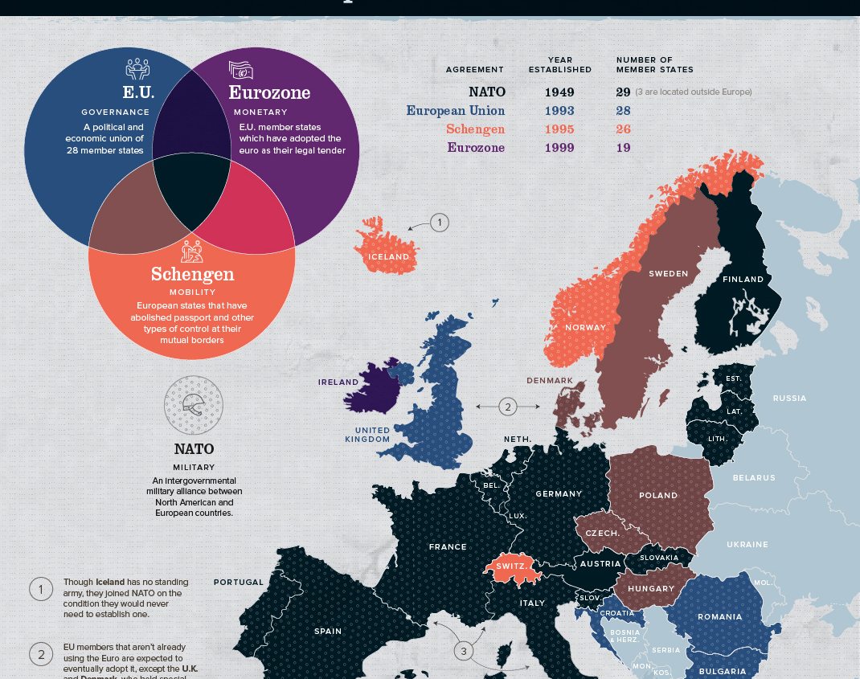
European Union – Functioning and Laws
28 Member States + European Commission, Council of the European Union, European Council, European Parliament
Competences: shared and exclusive
Legislative functions: directives and regulations
Direct applicability and primacy effect
Direct action by individuals and infringement procedure for non-implementation by the European Commission
Judicial co-operation in criminal and civil matters

Slide 4
EU Crime
Priorities

Slide 5
European Union – Functioning and Laws
Directive 2012/29/EU of the European Parliament and of the Council of 25 October 2012 establishing minimum standards on the rights, support and protection of victims of crime, and replacing Council Framework Decision 2001/220/JHA
Council Directive 2004/80/EC of 29 April 2004 relating to compensation to crime victims
Directive 2011/99/EU of the European Parliament and of the Council of 13 December 2011 on the European protection order
Regulation (EU) No 606/2013 of the European Parliament and of the Council of 12 June 2013 on mutual recognition of protection measures in civil matters
Directive 2011/92/EU of the European Parliament and of the Council of 13 December 2011 on combating the sexual abuse and sexual exploitation of children and child pornography, and replacing Council Framework Decision 2004/68/JHA
Directive 2011/36/EU of the European Parliament and of the Council of 5 April 2011 on preventing and combating trafficking in human beings and protecting its victims, and replacing Council Framework Decision 2002/629/JHA
Proposal for a DIRECTIVE OF THE EUROPEAN PARLIAMENT AND OF THE COUNCIL on combating fraud and counterfeiting of non-cash means of payment and replacing Council Framework Decision 2001/413/JHA
Council Framework Decision 2008/913/JHA of 28 November 2008 on combating certain forms and expressions of racism and xenophobia by means of criminal law
Directive (EU) 2017/541 of the European Parliament and of the Council of 15 March 2017 on combating terrorism and replacing Council Framework Decision 2002/475/JHA and amending Council Decision 2005/671/JHA

Slide 6
Impact of crime on the individual and society
Emotional and psychological impact
Practical difficulties
Financial impact
Help in accessing justice
Problems at work/school/ family life
Physical Consequences
Impact on Society
Social costs
Economic Costs
Justice costs

Slide 7
Impact of Crime
Impact of crime influences needs
Impact manifests itself in a variety of ways
Financial, in personal relationships, in social functioning, in jobs, in education, in health, personal satisfaction and well-being
Depends on the context – one cannot assume that low-profile crime does not impact victims or impacts them less than high-profile crime
Trauma and memory
Traumatisation as a driver for developing support services
Psychological first aid training: intervention at early stage reduced likelihood of developing later trauma

Slide 8
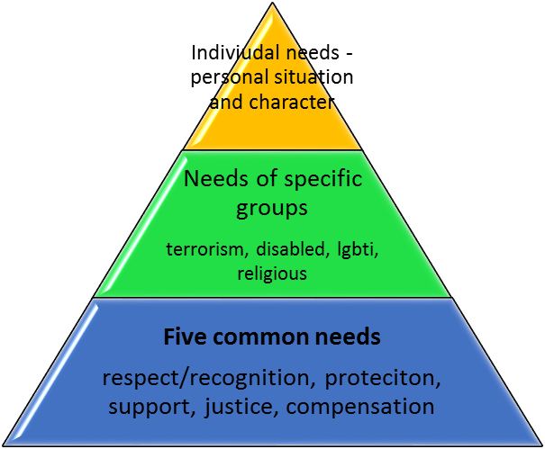
Victims needs is the starting point: Not budget, not resources, not time
Respect and Recognition
Support and Information
Access to Justice
Compensation and Restoration
Protection

Slide 9
THE EU VICTIMS DIRECTIVE

Slide 10
Objectives
Victims are recognised and treated in a respectful, sensitive, tailored, professional and non-discriminatory manner (art 1)
Victims are treated in a non-discriminatory manner – Without discrimination on the basis of gender

Slide 11
European Union Victims’ Directive
Definition of a victim
a natural person who has suffered harm, physical, mental or emotional harm or economic loss because of a crime
family members of a person whose death was directly caused by a criminal offence and who has suffered harm as a result
Main substantive rights under the Victims’ Directive
Right to information including interpretation and translation
Information provided in a timely manner, in simple, understandable and accessible language, targeted provision, proactive provision and upon request
Right to protection
From secondary and repeat victimisation, from intimidation, from retaliation, against the risk of emotional or psychological harm, to protect the dignity and privacy of victims
Support
Information, advice and support relevant to the right of victims including on accessing compensation, specialist support services, emotional and psychological help, advice relating to financial and practical issues, and the risk and prevention of secondary and repeat victimisation, of intimidation and of retaliation
Participation in criminal proceedings
Right to be heard, rights in the event of a decision not to prosecute, right to legal aid, right to reimbursement of expenses, right to the return of property
Training of practitioners
General and specialist training for officials who likely come into contact with victims, incentives through funding or through public services

Slide 12
Definition of victim in the Directive
All Victims of crimes
Committed in EU, as well as criminal proceedings in the EU for crimes that occurred outside of EU territory (also known as extra-territorial offences), where national law provides for this.
No matter the victim’s residence status (Article 1)
Anyone who has suffered physical, mental or emotional or economic harm caused by a criminal offence
Family Members of a person whose death was directly cause by the criminal offence
Children – under the age 18 years
Notes:
Crimes – thus a victim of gender-based violence is a victim under the Directive only when this violence constitutes a criminal offices under the legal regime of a member state – Not all forms of Gender based violence are criminalised
Family Members – spouse, person who is living with victim in intimate committed relationship, joint household and stable and continuous basis, relatives in direct line, siblings and dependants of the victim. Family members can be limited by the member state,
In Article 8 – on victim support – Member states must ensure that family members shall have access to victim support services in accordance with their needs and the degree of harm suffered as a result of the criminal offence committed against the victim.

Slide 13
Victim support

Slide 14
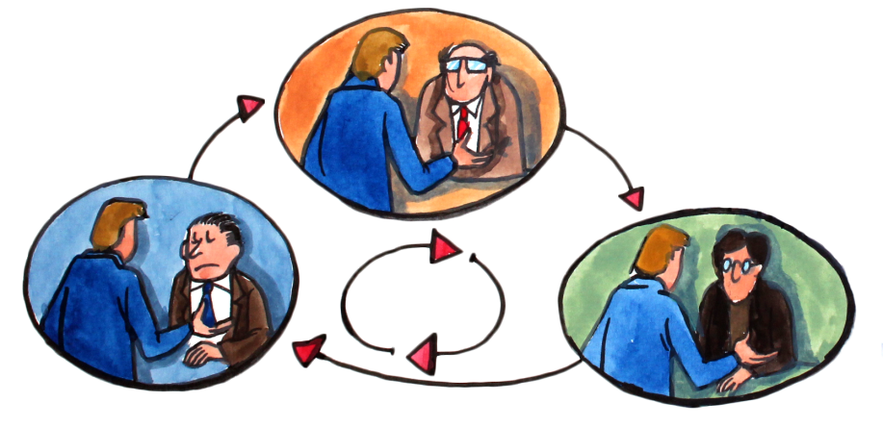
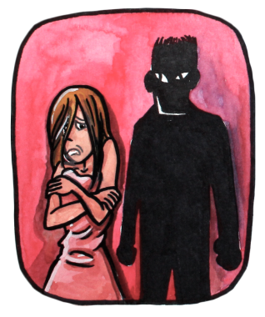
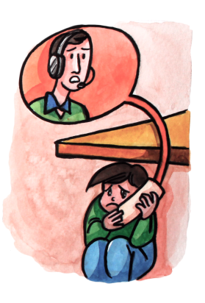
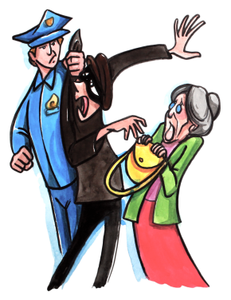
Support Requirements under the EU Victims’ Directive
Timing – before, during and after criminal proceedings
Irrelevant of complaint
Free and confidential
Family members
Continuity of support
Specialist and universal services

Slide 15
Victim Support – The EU Directive
For as long as victim needs * Irrelevant of complaint * Free & confidential * Family members * Continuity of support * Specialist and universal services
Information
Referral
Emotional support
Advice
Information on victims’ rights
Information on Compensation
Information on role in criminal proceedings
Advice on practical issues
Advice on financial issues
Information on specialised services
Direct referral
Advice on prevention
Advice on secondary and repeat victimisation
Emotional support
If needed psychological support
Preparation for attendance of the trial

Slide 16
Specialised victim support
3. Member States shall take measures to establish free of charge and confidential specialist support services in addition to, or as an integrated part of, general victim support services, or to enable victim support organisations to call on existing specialised entities providing such specialist support. Victims, in accordance with their specific needs, shall have access to such services and family members shall have access in accordance with their specific needs and the degree of harm suffered as a result of the criminal offence committed against the victim. (article 8)
3. Unless otherwise provided by other public or private services, specialist support services referred to in Article 8(3), shall, as a minimum, develop and provide:
(a) shelters or any other appropriate interim accommodation for victims in need of a safe place due to an imminent risk of secondary and repeat victimisation, of intimidation and of retaliation;
(b) targeted and integrated support for victims with specific needs, such as victims of sexual violence, victims of gender-based violence and victims of violence in close relationships, including trauma support and counselling.
Notes:
Victims with specific needs – can be linked back to preambule where Gender Based violence is named
The first part – of article – victim support organisations can refer – but othr articles and recitals aim to avoid repeat referral. Also repeat referral needs to be avoided. In the preambule the directive refers to a one-stop-shop. But there

Slide 17
Some core principles in the delivery of effective services
All victims
Universal/ generic and specialist services
Foundation for all
Respect
Direct interactions
Non-discriminatory
Empower
Individualised
Regularly reviewed
Accessible for all: geographical scope, reach out, referral, help them come forward
Co-ordination of services
At home and abroad
Relevant
Institutionalised in structures
Listen
Consult
Participation
Education and self help
Flexible
Targeted
Based on need (assessment)
Free of charge
For as long as needed
High quality, consistent standards
Transparent
Communication and information – multi-format, simple and accessible
Constant review and improvement
Self realisation

Slide 18
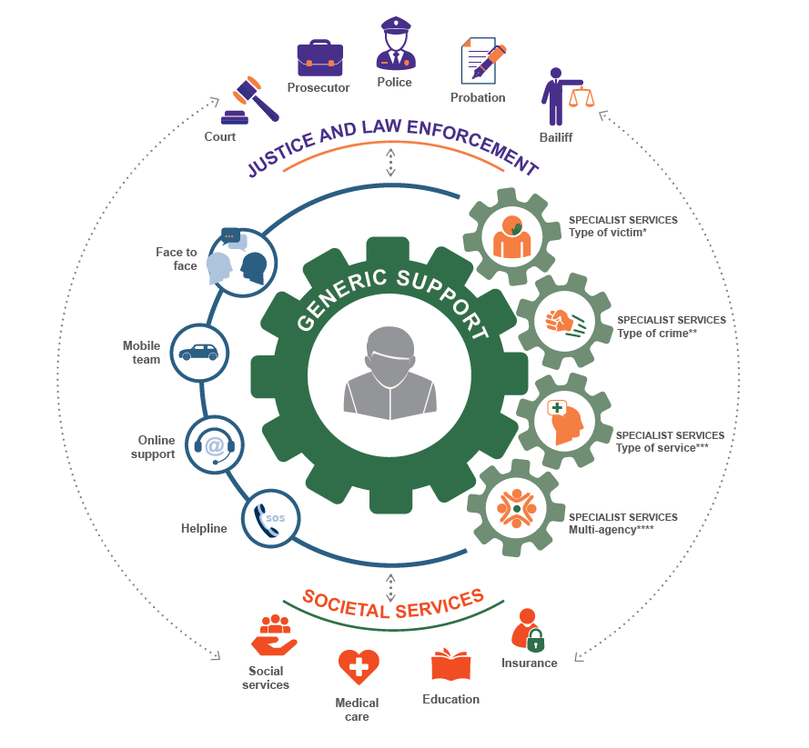
COMPREHENSIVE SUPPORT FOR ALL, BY ALL
Not forgetting:
Individual and community resilience
Victim social support network:
Family, friends, community
Private sector
Oversight, monitoring and review – long term change:
Ombudsmen
Commissioners
Inspectorates
Ministerial responsibility
Self evaluation/ survey
A national network building on existing and creating new services

Slide 19
Victim Support Structures
Single, national State funded NGO victim support organisation delivering for all victims of crime
Single State run victim support service (either an entity in its own right or an through an organisation which delivers other services)
A network of NGOs co-ordinated by a single body receiving funding through the State
A network of NGOs, co-ordinated by a Steering committee of the NGOs, funded through the State
A single NGO delivers national services but funds itself entirely
England
Netherlands
Croatia
Estonia
France
Finland
Germany
Notes:
Overarching point: of relevance to Serbian two fundamental approaches – having single entity or network of organisations
You can have the single entity being state or NGO
Network can be coordinated by Government body or NGOs
Reason that best performing countries take this route in order to have national delivery, quality, consistency, continuity and awareness amongst the population
Easier to fund, easier to ensure quality

Slide 20
Quality Standards
Quality standards encourage organisations to improve their care and respond better to victims’ needs, to work towards a continuous quality improvement and consistency in services
Quality standards strengthen public confidence in victim support services
Importance of indicators and assessment tools such as risk assessment or evaluation questionnaire and other unbiased verification of compliance
Specific for generalist and for specialist services
Tools for implementation: statute or constitution, equality and non-discrimination policy, accessibility policy, human resource policy, child protection policy, data protection policy, training policy, volunteering policy, risk assessment guidance document, applying for funding

Slide 21
VSE Standards and Accreditation Process for Full Members
STANDARD 1
Services are available without discrimination
STANDARD 2
Respect the dignity, rights, needs and feelings of the victim
STANDARD 3
Ensuring the confidentiality, safety and privacy of the victim
STANDARD 4
Ensuring tailored responses, according to the individual needs
STANDARD 5
Provide a variety of support options
SOS
STANDARD 6
Delivering for victims through referrals and coordination
STANDARD 7
Ensuring good governance structures
STANDARD 8
Achieving quality through training
STANDARD 9
Improving our services through monitoring and evaluation

Slide 22
Role of NGOs in Victims’ Support delivery
While both governmental and non-governmental actors take part in the provision of services, NGOs seem to dominate the sector. The survey indicates that the majority of generic and specialist services across Europe are delivered by NGOs.
It is apparent that to best support victims of crimes, both governmental and non-governmental actors must be involved in tending to their needs. This is best done in a coordinated and planned manner, which ensures cooperation and referral between different actors. To that effect, organisations may enter into different agreements, memoranda of understanding and protocols of cooperation.
NGOs are better at providing access to services for victims who might need support, and at adapting the way they provide service to respond to victims’ needs.
NGOs also seem better at delivering services by dedicated staff and through recruiting volunteers.
While NGOs may be better placed to provide many of these services to victims in an accessible, flexible and cost-effective manner, it is still the responsibility of the state to create an environment in which NGOs can effectively operate.

Slide 23
List of Resources
Tamar Dinisman and Ania Moroz, Understanding victims of crime: The impact of the crime and support needs, April 2017
National Victim Assistance Academy Track 1: Foundation-Level Training Impact on Crime on Victims, March 2010
The Impact of Victimization prepared by the Canadian Resource Centre for Victims of Crime, 2005
Rochelle F. Hanson, Genelle K. Sawyer, Angela M. Begle, and Grace S. Hubel, The Impact of Crime Victimization on Quality of Life, Journal of Trauma Stress 23(2), April 2010.

Slide 24
Human resources slide 10
Thank You
Levent Altan
Executive Director
l.altan@victimsupporteurope.eu
www.victimsupport.eu
@victimsupportEU
@victimsupporteurope

