Slide 1
Using strategic litigation to advance the rights of vulnerable groups 11 December, 2018 Arpi Avetisyan, ILGA-Europe

Slide 2
Who are ILGA-Europe?

Slide 3
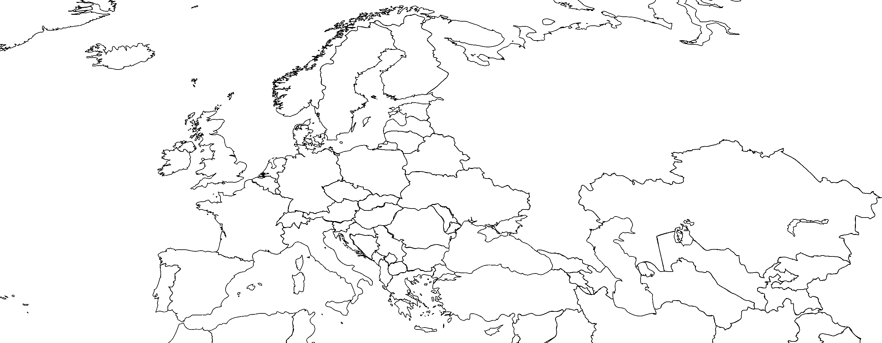
Who are ILGA-Europe?
500+ member organisations in 54 countries: Europe and Central Asia
Notes:
- A membership organisation

Slide 4
ILGA-Europe strategic litigation work
Part of a broader advocacy strategy
Standard setting and advancement of law
European level
Domestic level
International level
Support and empowerment of ILGA-Europe members
Awareness raising/legal education
Annual Inventory of cases – identification of gap areas
No direct representation, but referral to members/partners

Slide 5
Standard setting and advancement of law
European Court of Human Rights
Third party submission
Execution of judgments
European Social Charter – Committee on Social Rights
Collective complaints procedure
European Court of Justice
Legal advocacy
Implementation of judgments
UN Treaty Bodies
National level (rarely)
with spill over effect – High Courts

Slide 6
Support and empower members
Capacity development
Facilitate peer learning – strategy development, argumentation
Increasing resources to support members’ litigation work domestically through collaboration with Pro Bono lawyers

Slide 7
Case Study: hate crime/motive in domestic violence case in Serbia
2012 Criminal Code of the Republic of Serbia, Article 54a: Special circumstances for determination of a sentence for a hate crime, crimes motivated by hate due to race and religion, national or ethnic origin, sex, sexual orientation or gender identity shall be considered as a compulsory aggravating circumstance.

Slide 8
Case Study: domestic violence case in Serbia
Yucom Lawyers’ Committee for Human Rights represented the victim
Close collaboration with LGBTI organisations in Serbia
2018 first case to consider sexual orientation as motive in domestic violence case
Prompting other victims to come forward
Educative case for the judiciary, prosecution, lawyers in Serbia
Useful in comparative studies

Slide 9
Case study – M.C. & A.C v Romania
Applicants were participants in the pride march in June, 2006 – were attacked in the aftermath on the train (witnesses, even a photographer!)
Medical examination conducted
Criminal complaint lodged
No effective investigation – police station reorganisation
2011 police response: “... the investigation was rendered difficult by the fact that the file arrived at the Metro Police Station ... almost one year after the incidents, and the police agents ... who had been in charge of the case until September 2006 could not continue the investigation as the Intelligence Service had refused to cooperate and allow their agent ‒ who was the only identified eye-witness to the events ‒ to be interviewed; it is to be noted that the police lost their motivation to use the information for the purposes of finding the truth in this case, of identifying and bringing to justice those responsible.
…At the same time, it is observed that ... the criminal acts had become time-barred, removing criminal responsibility from the culprits.

Slide 10
Case study – M.C. & A.C v Romania
Case lodged before ECHR in 2012, ILGA-Europe and partners intervened in 2013
Mere law is not sufficient, implementation is key
Training of police
Chilling effect on wider LGBTI community

Slide 11
ECHR Judgment 2016
The treatment fell within the ambit of Article 3 taken in conjunction with Article 14 of the Convention.
Violation of Article 3 and 14: lack of effective investigation as authorities did not make use
“in any significant way of the evidence adduced by the applicants, specifically statements, photographs and the identification of some individuals in the group of attackers”
Disregard to the hate speech, uttered by the assailants during the incident
“without a meaningful investigation, it would be difficult for the respondent State to implement measures aimed at improving the policing of similar peaceful demonstrations in the future, thus undermining public confidence in the State’s anti-discrimination policy”

Slide 12
Implementation of the judgment
INITIAL STAGES:
4/16. Judgment – failure to investigate hate crimes, including hate motivation
4/16. ACCEPT start work on developing general measures; meet with ombudsman, govt agent;
7/16. judgment final
10/16: meetings with a range of ministries and police proposing general measures
Continuous consultations with ILGA-Europe
Collaboration with CoE SOGI unit

Slide 13
ACCEPT’s 1st Rule 9.2 (12/16)
Recommendations included
Data collection by police, prosecutors, courts, on crimes, inadequate, not harmonised, does not include discrimination ground
Initial and continuous training for police and legal professionals

Slide 14
1st govt action plan & 2nd ACCEPT Rule 9.2
1/17: Govt action plan. General measures: e.g.:
no undertakings given to take action at all
“the requirements of an effective criminal investigation on hate crimes ….. acknowledged … through ample professional initial and continuous training programs”
On data on hate crimes, “improvement of systems …. ongoing process”
3/17: ACCEPT Rule 9.2 response to Action Plan.
Demonstrated that training wholly inadequate (hate crime not covered, sexual orientation discrimination not covered, tiny proportion of target audience covered, “one-offs”.)
Demonstrated that data collection systems wholly inadequate
Include section on hate crime in planned police procedures for investigating and combating crimes
Notes:
Govt did not contest

Slide 15
Govt reply to 2nd ACCEPT Rule 9.2
Did not contest comments on judicial and police training;
Government Agent asked police to explore possibility that:
Police officers to document hate motive, if alleged by victim
Introduce guidance on conducting hate crime investigations

Slide 16
Subsequent developments in 2017
5/17:
“……. today ACCEPT had a very productive second meeting with the authorities, mediated by the Government agent. The police came up with concrete solutions for sustainable training. The General Prosecutor’s Office wants to draft procedures of investigating hate crimes that will be used by prosecutors and police officers.”
Later updates:
All day meeting at ACCEPT’s office between with officials and hate crime victims.
Prosecutor's office starting to develop hate crime investigation methodology and system for recording criteria for hate crimes under investigation.
The Ministry of Internal Affairs seem unable to come up with their own plan for significant and sustainable training for Police.

Slide 17
Situation reported on HUDOC-EXEC (early 2018)
The Romanian authorities are expected to provide:
− data on the number of complaints filed …… (including those related to the aggravating factor of hate crime) and on the number investigated and of the cases referred to the courts, together with information on the outcome of these cases;
− the additional announced professional training of judges, prosecutors and police and updates on the planned improvements to the data collection system of the Ministry of Justice; and
− information on the progress …. on adopting additional general measures to ensure the effectiveness of criminal investigations into hate crimes

Slide 18
Updated Action Plan 9/18
MoJ, Prosecutors’, Police data bases being amended to include discrimination ground; longer term improvements planned; alignment of police and prosecutors’ records under discussion.
Police/prosecutors preparing common methodology on investigation of hate crimes
Police Academy: developed new “trainer of trainers” programme on hate crimes;
For 2018/19 hate crimes in individual continuous training for all members of Romanian police

Slide 19
Lessons/suggestions?
Identify and publicise gaps in protection at European Level
Encourage and enable organisations/individuals to come forward with cases to fill in these gaps
Ensure availability of legal resources to support these gaps
Collaboration and building alliances
Comprehensive strategy: litigation + communication + advocacy

Slide 20
THANK YOU!
Arpi Avetisyan
Senior Litigation Officer, ILGA-Europe
arpi@ilga-europe.org

